Slide 1


In partnership with
President's Letter Agent
Scout Integration — From POC to Fully Integrated Module
March 2026
Note: The goal of this session is to share what Calance built in the POC, walk through the fully integrated product vision, and align on the President's Letter template structure and data sourcing approach — the two inputs that drive everything forward.
01
02
03
04
05
06
Scout Lifecycle
POC → Product
Product Screens
Architecture
Timeline
Next Steps
President's Letter Agent · Scout Integration · Confidential

Slide 2

In partnership with
🗺 Scout: An End-to-End Land Acquisition Platform
01
02
03
04
05
INPUT
LAR CRITERIA
TOP
PROFORMA
PRESIDENT'S LETTER
Research &
Input
Comparison
& Analysis
Triangle of
Potential
Financial
Model
President's
Letter ✦
▶
▶
▶
▶
Site data, community
context, deal details
Market comparables,
resiliency scoring
Land value justification
framework
Returns, absorption,
proforma
AI-generated approval
letter — NEW
What we're building
President's Letter Agent · Scout Integration · Confidential

Slide 3
In partnership with
🔄 From Standalone Prototype to Native Product
PROTOTYPE · TODAY
INTEGRATED PRODUCT · TARGET
Files
User manually uploads Excel proforma + prior Word letter examples
Data
AI reads directly from Scout deal data — no uploads needed
AI Model
GPT-4.1 mini
AI Model
Claude Sonnet 4.6 — vision, large context, superior synthesis
Location
Standalone app — lives outside Scout entirely
Location
Native tab in LAR — alongside Input, TOP, Proforma
▶
Data
Static — only what's in the uploaded files at that moment
Data
Live — always reflects current Scout deal data + supplemental inputs
Output
Draft text returned; no save, no workflow, no version tracking
Output
Draft opens in a full rich-text editor, inline AI assistant for refinement
Approval
No approval workflow — user copies output manually
Approval
Built-in workflow: Draft → In Review → Approved, with full audit trail
President's Letter Agent · Scout Integration · Confidential

Slide 4
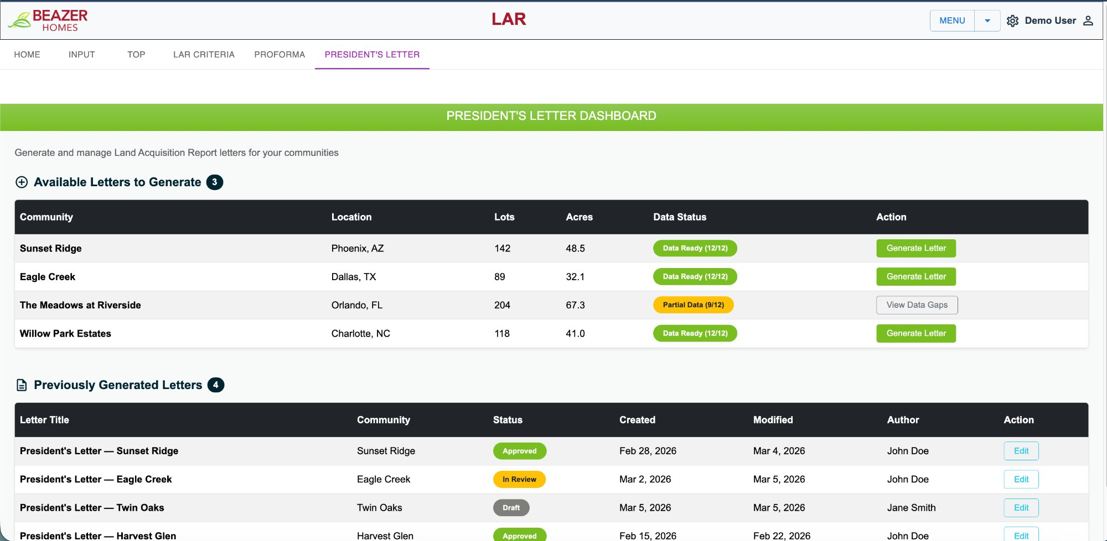
SCREEN 1 / 3
President's
Letter
Dashboard
All deals
in one view
See every community — data readiness, lot count, location — at a glance from a single dashboard
Data Ready
status
Green = all required data points confirmed. Amber = partial — system blocks generation until resolved
One-click
generation
Click 'Generate Letter' and the AI agent synthesizes all Scout data into a structured draft
Letter
history
Previously generated letters tracked by status: Draft, In Review, or Approved — with author and dates
President's Letter Agent · Scout Integration · Confidential

Slide 5
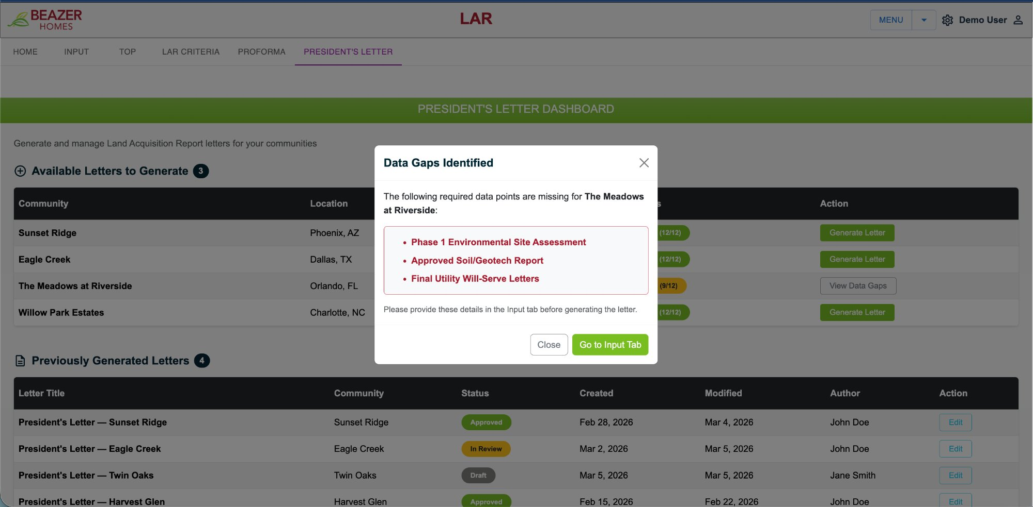
SCREEN 2 / 3
Intelligent
Data Gap
Detection
Knows exactly
what's missing
Before generation, the system validates all required data points against the deal record in Scout
Named fields,
not vague errors
Lists precisely which documents are absent — Phase 1, Soil/Geotech Report, Utility Will-Serve Letters
Guided
resolution
'Go to Input Tab' routes the user directly to the specific field needing attention
Quality
gate
No letter is generated until requirements are satisfied — enforces data completeness before AI runs
President's Letter Agent · Scout Integration · Confidential

Slide 6
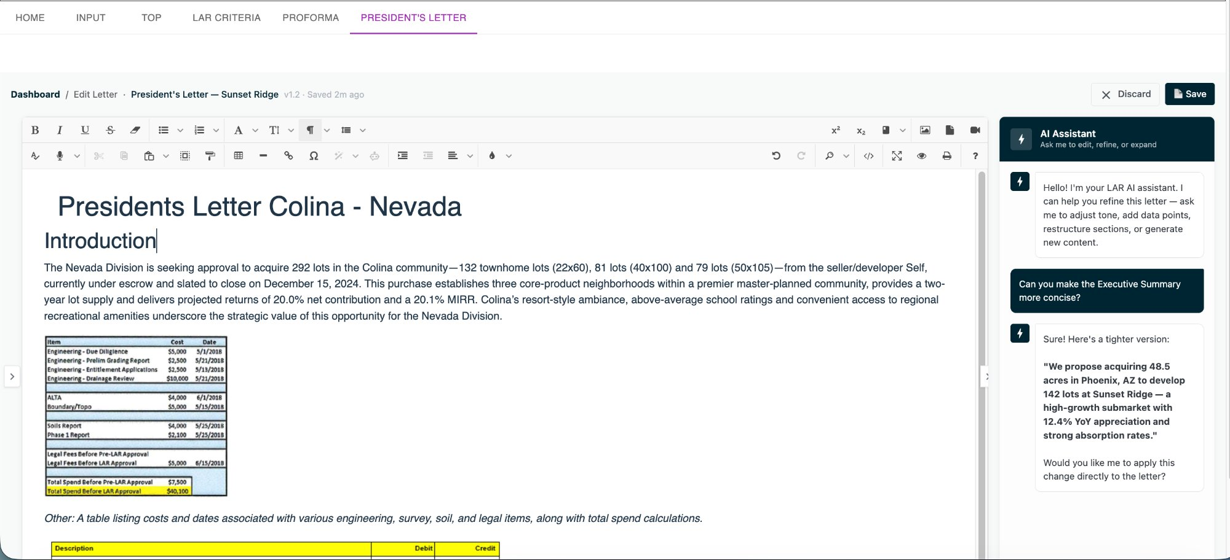
SCREEN 3 / 3
AI Letter
Editor &
Assistant
Generated
in-app
Letter draft opens immediately in a full rich-text editor — no downloading, no copy-paste, no separate tool
Inline AI
assistant
The AI assistant panel knows the deal context — ask it to tighten a section, add a data point, or restructure
Version
history
Every edit saves a version (v1.1, v1.2…) with timestamp and author — full audit trail from day one
Approval
workflow
Status progresses Draft → In Review → Approved, visible to the entire team across communities
President's Letter Agent · Scout Integration · Confidential

Slide 7
In partnership with
⚙️ Technical Approach — Three Guiding Principles
01
02
03
🔒 Zero Impact on
Existing Scout
🗄 New Data, Cleanly
Separated
⚡ Claude AI Powers
the Agent
No changes to the .NET backend, no edits to existing database tables, no risk of regression in current workflows.
The President's Letter service sits alongside Scout — reading data via API, not modifying it.
Supplemental inputs not yet in Scout — Phase 1 assessments, utility will-serve letters, site imagery — are stored in new tables linked by deal ID.
Existing schema is untouched.
Upgrading from GPT-4.1 mini to Claude Sonnet 4.6 — a context window large enough for complete 40-page letters, vision capability for maps and imagery, and significantly better narrative output.
President's Letter Agent · Scout Integration · Confidential

Slide 8
In partnership with
📅 Approximately Six Weeks from Green Light to Production
~223 hrs
~6 Weeks
0
Parallel streams mean ~6 weeks calendar time — not 223 hours end-to-end. AI agent, backend, and UI work simultaneously.
Combined effort
across all streams
Calendar time to
production-ready
Changes to existing
Scout .NET code
Week 1
Wk 2–3
Wk 4–5
Week 6
Kickoff &
Data Mapping
Parallel
Build
Integration
& Refinement
QA &
Launch
Align with project team on letter sections
AI generation pipeline — Scout → Claude → draft
Connect AI agent to live Scout data
End-to-end testing across communities
▶
▶
▶
Map Scout DB to letter data requirements
New DB tables + Azure Functions service
Inline AI assistant + editor integration
UAT with Beazer team
Define schema for supplemental tables
Dashboard UI + letter editor shell
Data gap detection UI + guided resolution
Deployment & go-live
President's Letter Agent · Scout Integration · Confidential

Slide 9
In partnership with
🤝 What Calance Needs to Move Forward
Three Inputs That Unlock Full Build
Questions & Discussion
01
President's Letter Template Validation
What sections of the President's Letter are non-negotiable vs. deal-specific?
Calance analyzed 5 existing letters to distill common sections and has mapped Scout raw data to cover 80%+ of the content. Validation of this template structure — section names, order, and critical vs. optional fields — is needed before the generation agent is finalized.
Which data points matter most — school ratings, market indices, environmental flags?
02
Data Sourcing Decision for the Remaining Gap
Is there a preferred format or approval chain for the letter once generated?
Approximately 20% of President's Letter content (Phase 1 assessments, utility will-serve letters, deal narrative context) does not yet exist in Scout. A decision is needed: should this supplemental data live in Scout (new tables) or be uploaded separately at letter-generation time?
Are there deals in flight that would make good validation candidates?
03
Two Real Deals for End-to-End Validation
To prove the integrated agent end-to-end, Calance needs two real Scout deal records to generate draft letters against. Selection of representative deals ensures the test reflects real data and enables immediate feedback on output quality.
What does 'done' look like for this feature from Beazer's vantage point?
What does success look like ?
President's Letter Agent · Scout Integration · Confidential

